Slide 1
PLACES WHERE WE CAN FOUND EQUALITY

Slide 2
Presented by
Riddhonil Ghosh, Grade-5D

Slide 3
Place where we get equality.
Law and order
Hospital
School, college, university
Grocery shop
Parlour
Restaurant
Wasa
Super shop
Desco
Roads and Highways
Park
Sea beach

Slide 4

Law and order
Law and order of a country gives the equal rights for the citizen of the country.

Slide 5
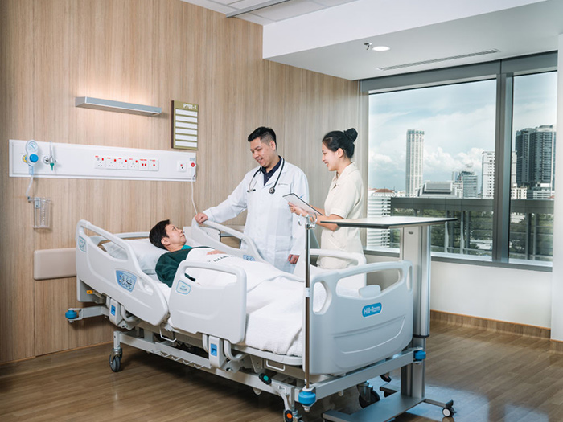
Hospital
We can get equality in hospital. Because doctors, nurses and all staffs of hospital give their care equally to the patient.

Slide 6
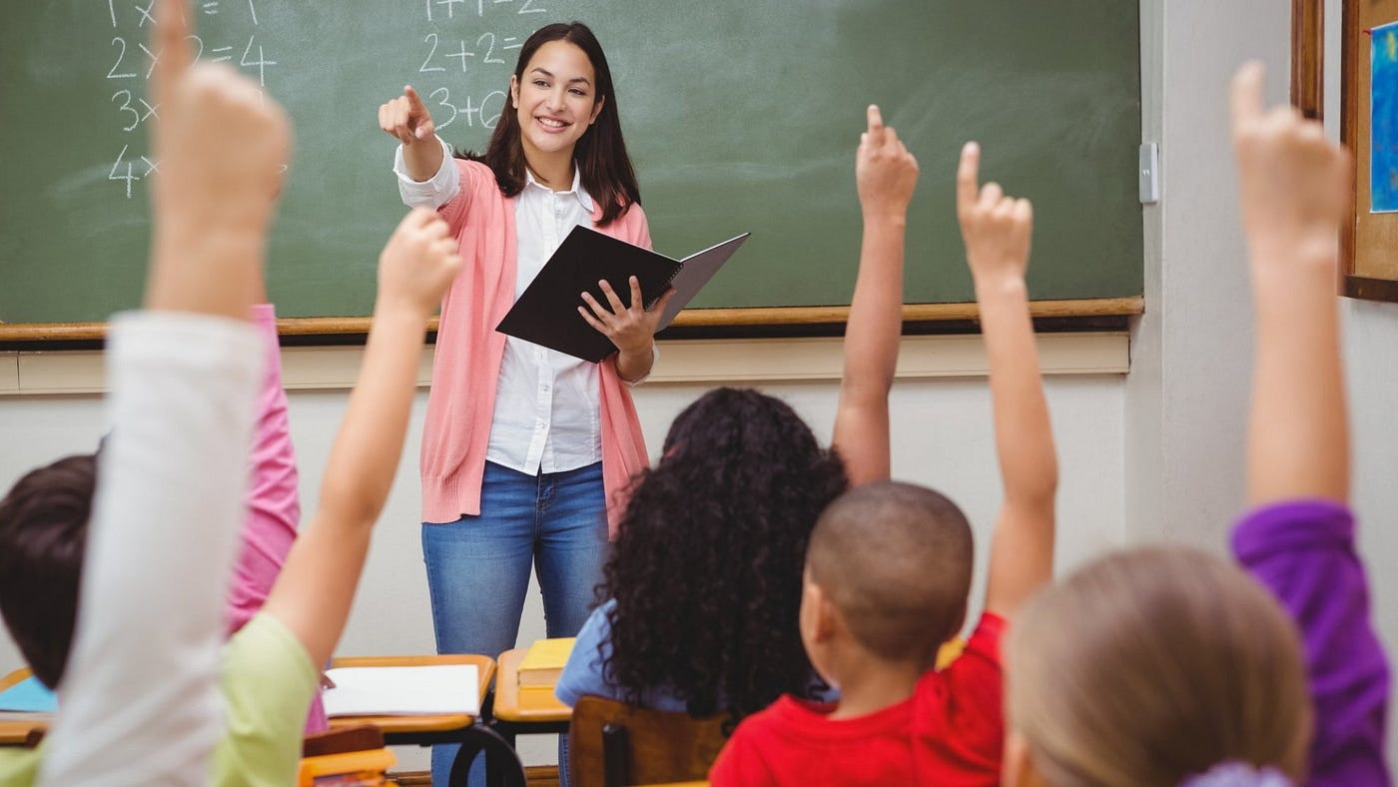
School, College, University
Students get education equally from school, college, university. Because teachers tech them equally. Students got equal rights.

Slide 7
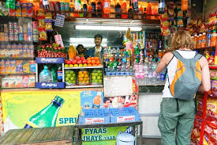
Grocery shop
People can buy the product equally from a grocery shop

Slide 8
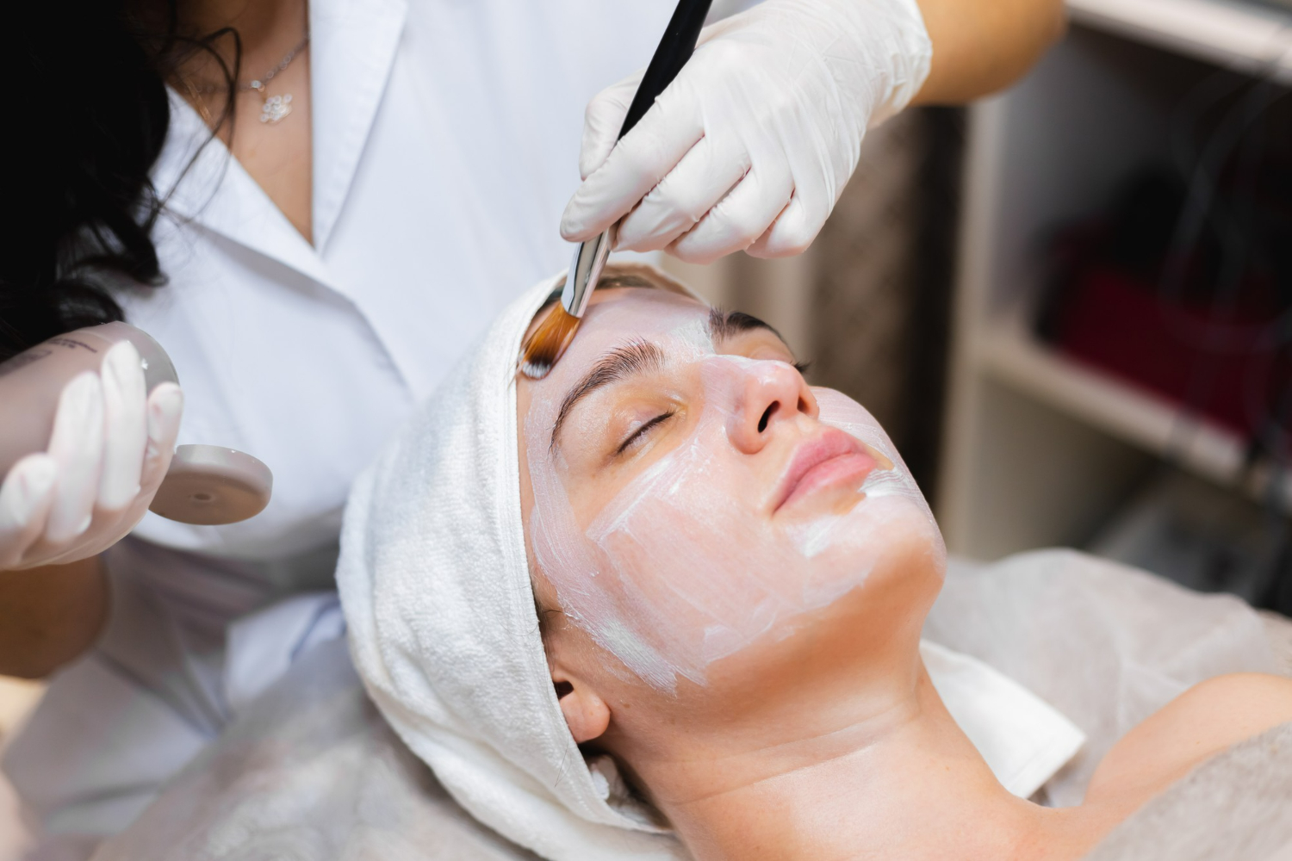
Parlour
In parlour we get equally service cause the barber cuts the hair for every one.

Slide 9
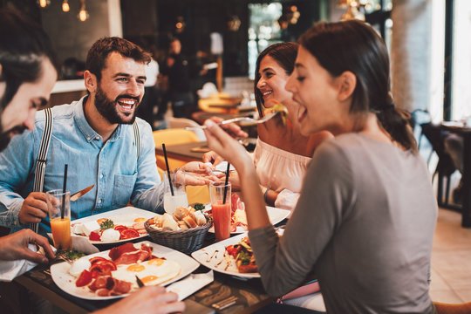
Restaurant
People get equally service of food in restaurant.

Slide 10

WASA [Dhaka Water Supply And Sewerage Authority]
All the citizen of Dhaka gate equal service from WASA

Slide 11
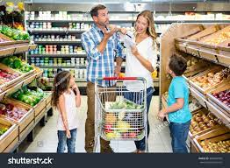
SUPER SHOP
Everybody get the same facilities from super shop

Slide 12

DESCO
DESCO gives electric supply to all of the citizen of Dhaka equally

Slide 13
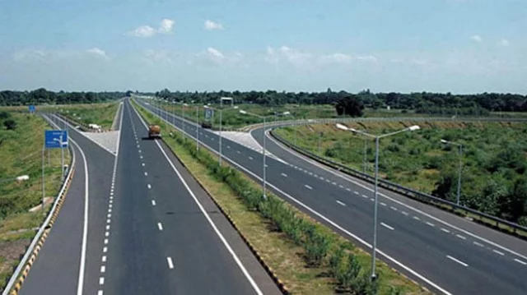
Roads and Highways
People can enjoy all the govt. Roads and Highway equally.

Slide 14
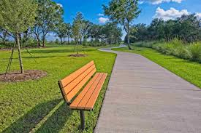
Park
People can happily roam in govt. Parks equally.

Slide 15
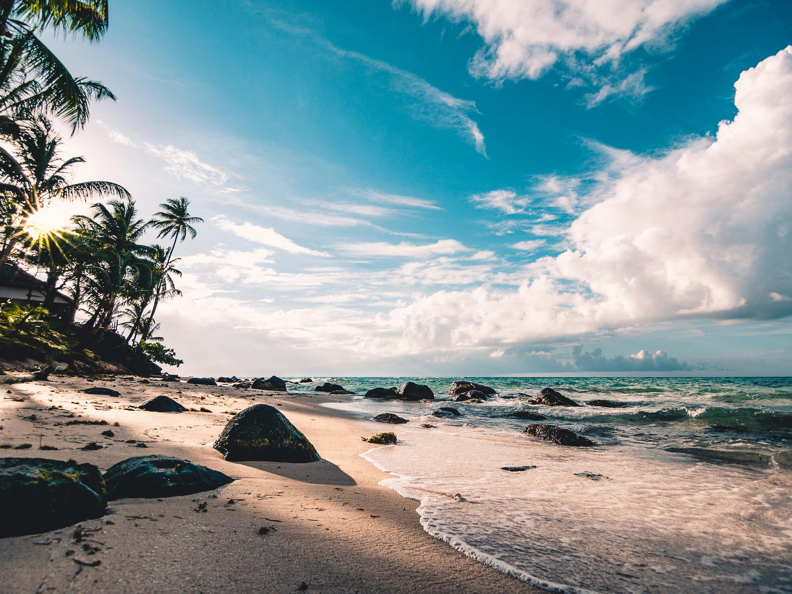
Sea Beach
People have the same equal right to roam at the sea beach.

Slide 16
Thank you

